Slide 1
Long Division
Quello Center
Michigan State University
29 June 2015, 2pm
The Ongoing and Increasing Importance of Digital Inequality Research
Dr. Bibi C. Reisdorf

Slide 2
Overview
Digital divide vs. digital inequality
  “Traditional” factors
  Consequences
  Additional factors
  Recent and ongoing studies
Policies
The US, MI, and Detroit context
Possible future research

Slide 3
Digital Divide vs. Inequality
Original digital divide as the gap between haves and have-nots, physical access vs. no access, and (later) use and non-use
Focus on binary differentiation
Policy focus on providing infrastructure and physical access, e.g. broadband and computers

Slide 4
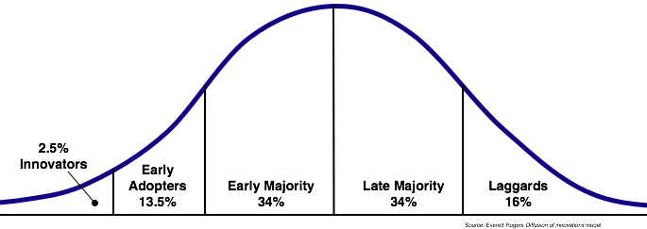
Digital Divide vs. Inequality
The digital divide is “the gap that exists between individuals advantaged by the internet and those individuals relatively disadvantaged by the internet” (Rogers, 2001: 100).

Slide 5
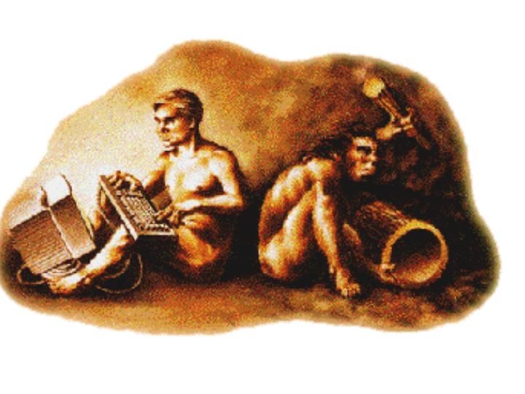
Digital Divide vs. Inequality
Move to several types of access divides (Van Dijk and Hacker, 2003):
  Mental access (motivation)
  Material access
  Skills access
  Usage access
Notes:
Early on Van Dijk and Hacker developed a hierarchical model of various types of access that prevent people from making the move online.

Slide 6
Digital Inequality
No binary definition, but differences in usage (e.g. DiMaggio et al., 2001; Zillien & Hargittai, 2009)
  Quality & location of access
  Skills
  Motivation
  Frequency of use
  Breadth of use
Notes:
The move away from binary definitions also means that non-user populations have recently been overlooked a lot in research, as the focus is currently on the differences between various types of internet users.

Slide 7
“Traditional” Factors
Income
Age
Education
Gender (in low penetration regions)
Occupation/Employment
Urban/Rural
…
Notes:
These are the core factors that are usually included in digital divide and inequality research, which is mainly of quantitative nature.

Slide 8
Consequences
“Overall, we find that a user’s social status is significantly related to various types of capital-enhancing uses of the Internet, suggesting that those already in more privileged positions are reaping the benefits of their time spent online more than users from lower socioeconomic backgrounds” (Zillien & Hargittai, 2009: 287).

Slide 9
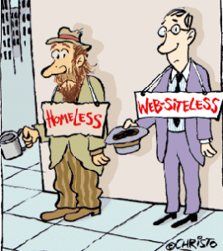
Consequences
A digital underclass has “incorporated the internet into fewer aspects of their everyday lives over the years and, while their use has increased, they are becoming relatively more disadvantaged compared to other internet users” (Helsper, 2011: 14).
Notes:
If this is true for people who are online, but barely so, we can expect even stronger negative consequences for those who are completely offline.

Slide 10
Consequences
“The majority of families in some of the US’s poorest cities do not have a broadband connection, according to a Financial Times analysis of official data that shows how the ‘digital divide’ is exacerbating inequality in the world’s biggest economy.
US cities that have become synonymous with urban decay, such as Detroit and Flint in Michigan and Macon in Georgia, have household broadband subscription rates of less than 50 per cent, according to the US Census Bureau data. The median household income in all three is less than $25,000 a year” (Crow, 2014).
Notes:
We will look at this specific context more later in this presentation.

Slide 11
Additional Factors
Culture
Neighborhood
Attitudes
Social Networks
Skills/literacy/language barriers
…
These factors are not usually considered in “traditional” digital inequality research
Notes:
Helsper (2012) developed a “corresponding fields” model that includes non-traditional factors, such as cultural factors, value systems, attitudes and social networks. However, in most studies, these factors are not considered, as they are hard to “measure”, especially in a quantitative research context.

Slide 12
Recent Studies
“Changing reasons for digital exclusion over time in Great Britain and Sweden”
  Quantitative analysis of OxIS and WIP Sweden data from 2005-2013
  Changes in socio-economic factors and changes in reasons for being offline
  Non-user populations becoming more concentrated in vulnerable groups
  Reasons for being offline diversify
    Access and cost still important
    Skills and interest increasing
Notes:
Data analysis conducted with Ellen J. Helsper from the London School of Economics. Cross-sectional data that we compared with logistic regressions to examine whether the link of digital connectedness and classic inequality factors has changed/increased, etc.
The results mostly support this hypothesis as the non-user population shrunk in both countries and belonging to a vulnerable group became a stronger predictor of being a non- or ex-user, evidenced by an increase in the predictive power of the models for non-use and ex-use over time. in a more general sense, digital exclusion has entrenched itself amongst the most vulnerable (i.e. lower educated, retired and socially isolated).

Slide 13
Recent Studies
Base: Non-users of the Internet (weighted): GB: 2005 N=709, 2007 N=649, 2009 N=471, 2011 N= 466, 2013 N=483.
** Difference between 2013 and 2005 significant at p<.01
Notes:
We thought that cost and access would decrease in importance, but found that they remain equally important throughout the years; interest has gained in importance.
We found that non-users are still facing a large number of barriers that include socio-economic factors, but also motivational and attitudinal factors.

Slide 14
Recent Studies
“Living offline: A qualitative study of internet non-use in Great Britain and Sweden”
  Qualitative (25–55 year-old Internet non-users)
  Variety of reasons for being offline:
    Lack of life-fit (not relevant/interesting)
    Lack of physical access
    Fear of breaking things
    Discomfort with technology in general
  Variety of feelings about being offline:
    Stigma/being “different”
    Comfort
Notes:
Qualitative study conducted in 2012 with Ann-Sofie Axelsson from Chalmers University and Hanna Maurin-Söderholm from Borås University.
Variety of results regarding reasons for being offline and feelings about being offline
No one had just one reason; always a combination of various reasons; accordingly, policies that tackle just one barrier won’t do the trick.
Surprisingly, those who were generally well off (highly educated and/or high income) were most comfortable with being offline as they had others do things online for them (e.g. a PA); those who were socio-economically disadvantaged struggled the most, felt left out, etc.
Proxy-use was on the one hand helpful, as respondents made (very limited) use through others, BUT was also a huge factor holding people back from doing things themselves (e.g. it’s easier/faster if someone else does it for me)

Slide 15
Interlude: Forgotten Populations
Anyone who is marginalized
  Poor neighborhoods/regions
  Rural and/or remote communities
  Minorities
  Prisoners
  …

Slide 16
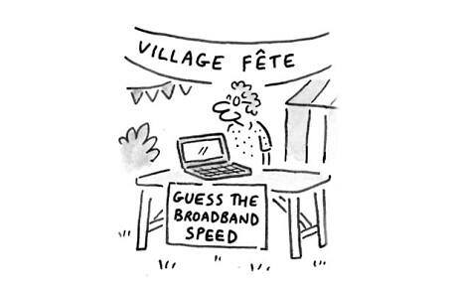
Ongoing Studies
“Access Denied: Broadband in Rural England and Wales”
  Qualitative interviews + expert interviews
  Findings show serious issues in both shallow and deep rural areas
    Slow
    Unreliable/cutting out
  Many alternative “solutions” not viable in rural areas
Notes:
OxIS 2013 survey found that nearly a third (31%) of those living in deep rural areas say that their internet speed is always too slow for what they want to do, compared with 20% in shallow rural areas and only 6% in urban areas (Dutton & Blank, 2013).
Shallow rural: town & fringe–less sparse and village, hamlet & isolated dwelling–less sparse
Deep rural: town & fringe–sparse and village, hamlet & isolated dwelling–sparse
Slow internet connections in rural areas in Great Britain have been an issue for long
Recognized by government
BT (British Telecom) won bids for every single area; are now pulling out of many areas as it’s not “economically viable”
The solutions provided are inadequate: FTTC instead of FTTH/P
Can’t do important things, such as online banking, paying wages, etc.; People cannot work from home; VPN doesn’t work most of the time; You may lose data; it’s not just the individuals who are inconvenienced, but also their employers and companies; families, mountain rescue
Issues are even more severe in poorer areas, where a reliable connection could provide employment opportunities (businesses wouldn’t have to move into cities) and other opportunities.
Landlines are being used more; mobile internet is not an option as there is no 3G or 4G in the village; people sometimes go to other places to get faster internet; some people even bring documents over to other people on a USB stick rather than sending it as an attachment, because it’s faster to drive there than to wait for the internet to work and upload it.

Slide 17
Policies
Policies in high-penetration countries mostly tackle physical access barriers
  E.g. provision of free or tax-free hardware
  “The Federal Communications Commission on Thursday voted 3 to 2 along party lines to approve a proposal to explore subsidizing broadband Internet for poor Americans. The plan, introduced last month by the agency’s Democratic chairman, Tom Wheeler, helps pave the way for sweeping changes to a $1.7 billion phone subsidy program” (Ruiz, 2015).

Slide 18
Policies
Some policies tackle(d) skills
  E.g. UK Online Centers
  Community programs
  Digital champions
Recent changes show a move back to infrastructure and physical access

Slide 19
The US, MI, Detroit Context
US context: 84% internet users (stagnation since 2012)
  http://www.pewinternet.org/2015/06/26/americans-internet-access-2000-2015/
Classic patterns of digital inequality persist
Notes:
The stagnation in internet usage indicates that the problem will not, as many say, die out in the next few decades. We see similar patterns in other high penetration countries.

Slide 20
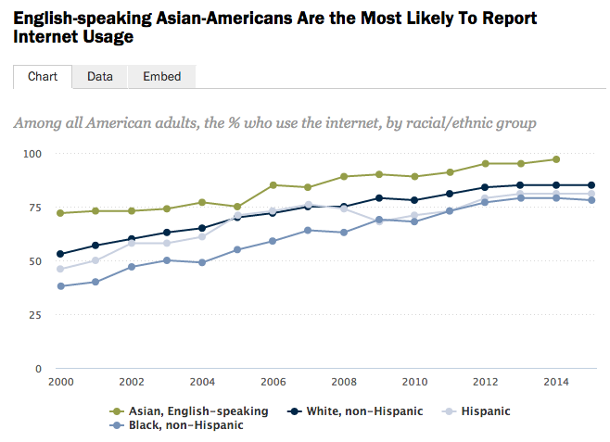

Slide 21
The US, MI, Detroit Context
  Michigan statistically above average in computer ownership but below average in home internet access numbers (U.S. Census Bureau, 2013)
  88.6% have access to a computer at home (vs. 88.4% US average)
  76.3% have high-speed internet access at home (vs. 78.1% US average)

Slide 22
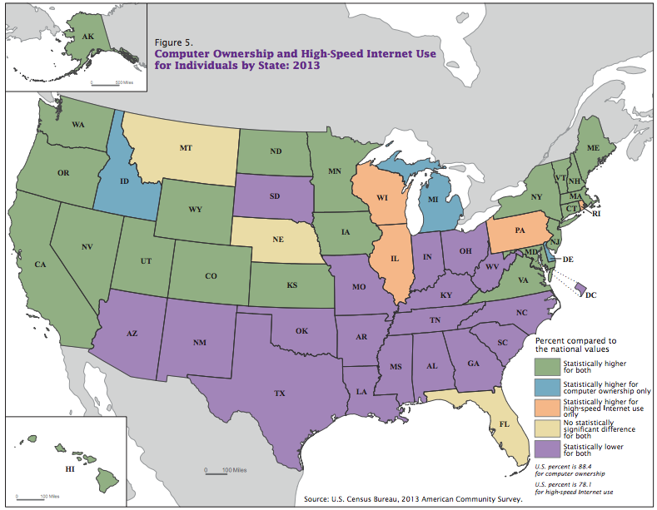
Notes:
This map shows that for Michigan, we find statistically higher computer ownership only, but as mentioned on the other slide, internet connectivity is below average.
However, we see the highest inequalities in the Southern States and some states in the Midwest, where we also find the strongest inequalities/highest poverty rates.

Slide 23
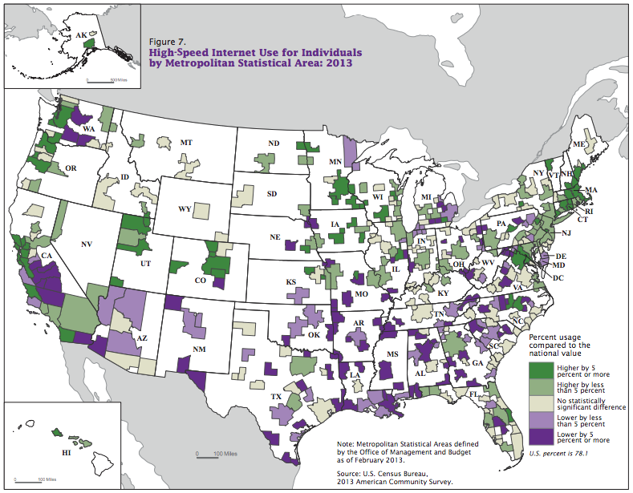

Slide 24
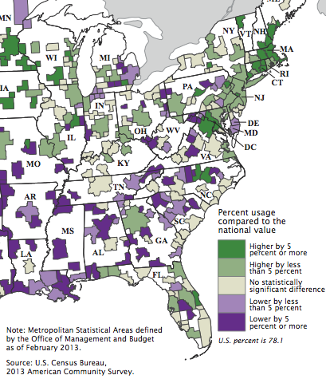
Notes:
Numbers in Michigan:
Highest in Ann Arbor (85.7% vs. 78.1% US average)
Lowest in Monroe (North of Toledo, OH with 66.9% vs. 78.1% US average)
However, these numbers are just for household connections and not for mobile connections or data plans.

Slide 25
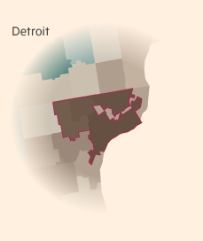
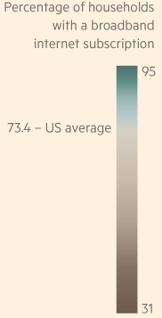
The US, MI, Detroit Context
Source: Crow, 2014.
Notes:
Internet subscriptions are extremely low in Detroit, in some areas as low as 31%.

Slide 26
Possible Future Research
ICT4Detroit: The Role of ICT in Collaboration for Detroit’s Revitalization
  ICT use in revitalization efforts and obstacles
  Initial focus on role of collaborative networks
Expand project by adding a non-organizational component:
  Community involvement
  Individual perceptions of Detroit’s population(s), especially in the most affected neighborhoods
  Initially qualitative

Slide 27
Possible Future Research
Mixed-methods study of internet access and use in Michigan
  Survey of general use across the state
  Qualitative component in select areas (e.g. problematic areas identified in previous research and the survey)
  Focus not only on status quo, but combine with findings from ICT4Detroit, inform communities/policymakers, etc.
Model for a larger study across the US
  Some quantitative data available (e.g. Pew Internet or Census), but lack of in-depth data that provide a more complete picture
Notes:
A mixed methods study across Michigan would allow for a more detailed analysis of the status quo and the issues that communities and individuals are struggling with.
What we have so far are snapshot data and no in-depth data. As there is no “single” solution to tackle digital inequalities, we need a larger (and ideally panel) study of internet use and non-use across the state and the country to be able to develop feasible solutions. What works in Detroit (although we don’t know yet if it will work), might not work in Waco, TX or Macon, GA.

Slide 28
Thank you!
@bibireisdorf

Slide 29
Sources
Crow, D. (2014). Digital divide exacerbates US inequality. Financial Times. Online: http://www.ft.com/cms/s/2/b75d095a-5d76-11e4-9753-00144feabdc0.html
Helsper, E.J. (2011). The Emergence of a Digital Underclass. Digital Policies in the UK and Evidence for Inclusion. LSE Media Policy Project: Media policy brief 3. London: London School of Economics.
Perrin, A., & Duggan, M. (2015). Americans’ Internet Access: 2000-2015. Pew Research Center. Online: http://www.pewinternet.org/2015/06/26/americans-internet-access-2000-2015/
Ruiz, R.R. (2015). F.C.C. Will Continue Plan to Subsidize Broadband for the Poor. The New York Times. Online: http://www.nytimes.com/2015/06/19/business/fcc-will-continue-plan-to-subsidize-broadband-for-the-poor.html?partner=rss&emc=rss&_r=1
Rogers, E. (2001). Digital divides revisited: what is new about divides and their research? Convergence, 7(4), 96-111.
U.S. Census Bureau (2013). Computer and Internet Use in the United States: 2013.
Van Dijk, J. &, Hacker, K. (2003). The Digital Divide as a Complex and Dynamic Phenomenon. The Information Society, 19, 315–326. London/New York: Routledge.
Zillien, U., & Hargittai, E. (2009). Digital Distinction: Status-Specific Types of Internet Usage. Social Science Quarterly, 90(2), 274-291.

